Slide 1

Correlating Patient Feedback to Avoidable Readmissions and Patient Experience Outcomes
Sponsor Company: Tallahassee Memorial Healthcare
By: Hailey Skoglund, Gus Lipkin, & Maverick Hope
Data Analytics Capstone I

Slide 2
Background
Tallahassee Memorial Healthcare (TMH) is a private, not-for-profit community healthcare system that serves a region of 17 different counties throughout north Florida and southern Georgia.
We have three research questions centered around patient feedback
We are currently working on research question two and will move to one and three next

Slide 3
Patient Readmission rates are a nationally recognized measure used for quality control and one that TMH is actively working to reduce. Can we identify patient response characteristics that are more likely to lead to readmission?
Current Goal

Slide 4
Project Charter
A standard project charter that reiterates our project goals and guidelines

Slide 5
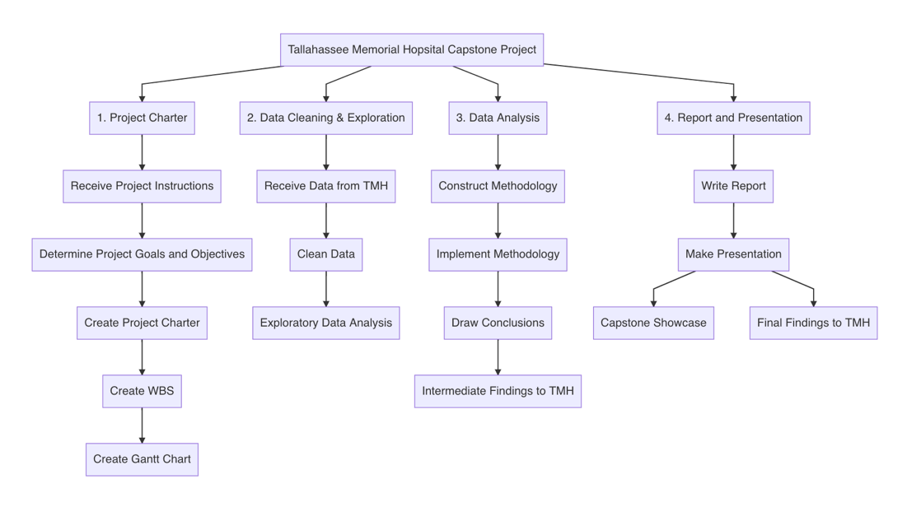
Work Breakdown Structure
A nice work breakdown structure

Slide 6
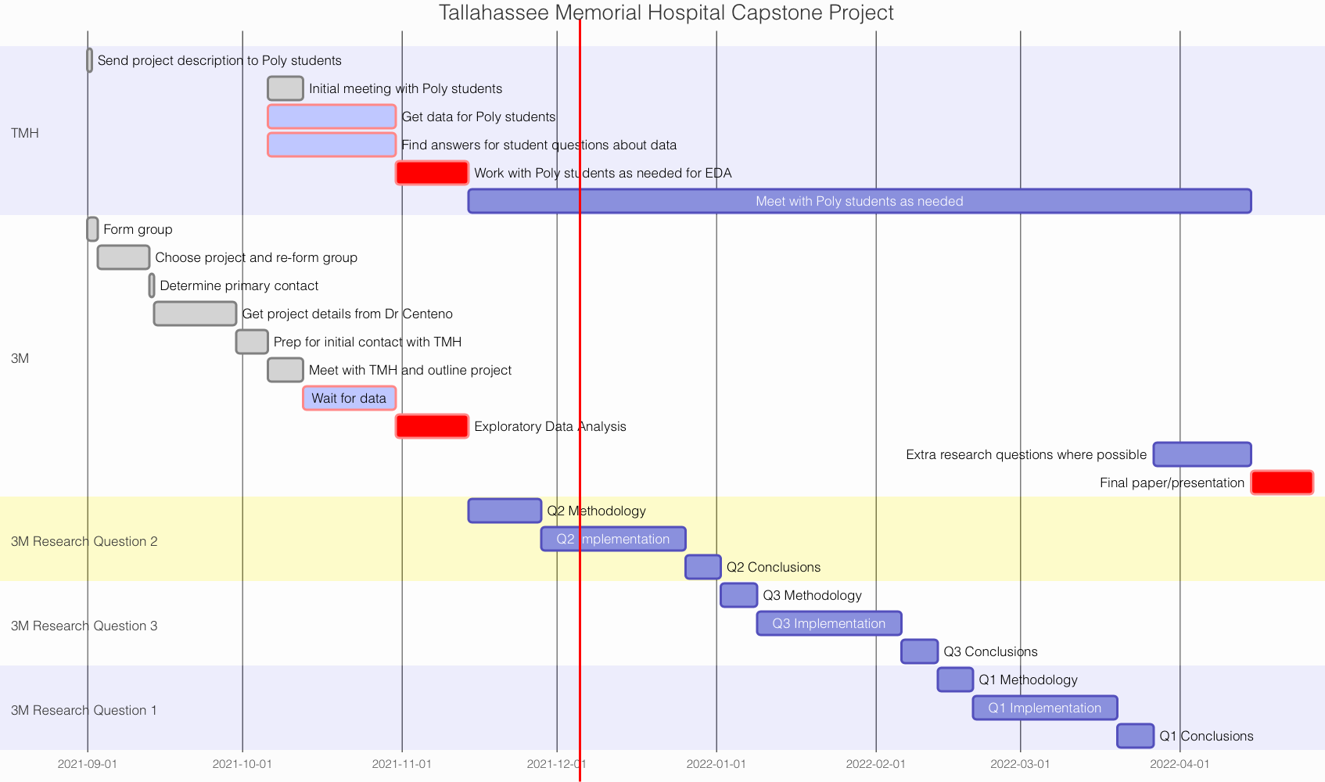
Gantt Chart
A pretty Gantt chart updated on December 5, 2021

Slide 7
Data
Connect Calls
Encounters
Readmissions
Surveys

Slide 8

Connect Calls
Connect calls are automated follow-up phone calls within a day of patient discharge
Consist of a series of questions that can be flagged for follow-up depending on the response

Slide 9

Encounters
A list of every visit to the hospital where you are checked in
Basic demographic data
Small amounts of hospital data such as attending physician, principal diagnosis, and discharge unit

Slide 10

Readmissions
Builds on Encounters by detailing which encounters are readmissions
Has much of the same data as encounters, but this time for the subsequent visits

Slide 11

Surveys
This is where the HCAHPS survey data comes from
Has an EncounterID and the entire survey response from the patient

Slide 12
Can we identify the patient response characteristics that have the strongest relationship to the two outcomes (readmittance vs non-readmittance)?
Research Question Two

Slide 13
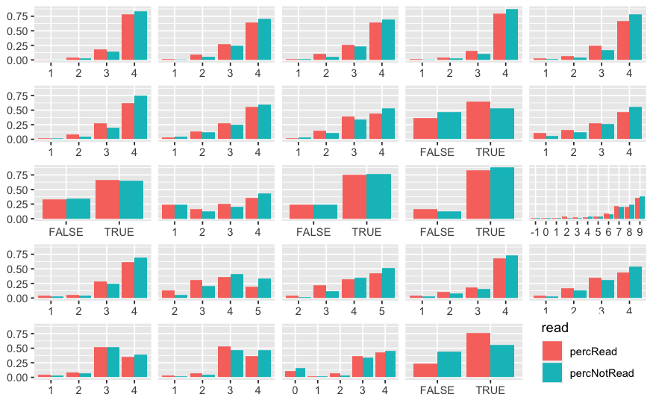
Analysis
Readmitted patients generally…
gave lower ratings
were more poorly informed about their care
were more likely to have been admitted through the ER

Slide 14
Next Steps
Continue investigating the differences between survey responses for patients that were readmitted and not readmitted
Construct a regression to try and model readmission and use that to identify which variables are the best predictors

Slide 15
Correlating Patient Feedback to Avoidable Readmissions and Patient Experience Outcomes
Sponsor Company: Tallahassee Memorial Healthcare
By: Hailey Skoglund, Gus Lipkin, & Maverick Hope
Data Analytics Capstone I

